Slide 1
Syntax - Introduction
Pawan Goyal
CSE, IIT Kharagpur
Week 5: Lecture 1
Syntax
Week 5: Lecture 1
1 / 14

Slide 2

What is Syntax?
Refers to the way words are arranged together, and the relationship between then.
Language Models: Importance of modeling word order
POS categories: An equivalence class for words
More complex notions: constituency, grammatical relations, subcategorization etc.
Syntax
Week 5: Lecture 1
2 / 14

Slide 3
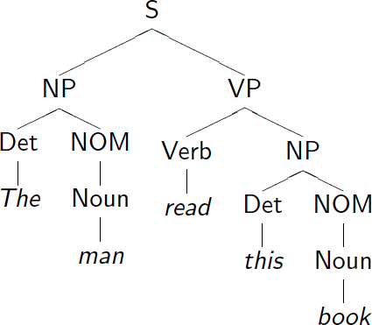
Syntax Tree: Example
Syntax
Week 5: Lecture 1
3 / 14

Slide 4
Defining the notions: Constituency
Constituent
A group of words acts as a single unit - phrases, clauses etc.
Part of Speech - “Substitution Test"
The {sad, intelligent, green, fat, ...} one is in the corner.
Constituency: Noun Phrase
Kermit the frog they
December twenty-sixth
the reason he is running for president
Syntax
Week 5: Lecture 1
4 / 14

Slide 5
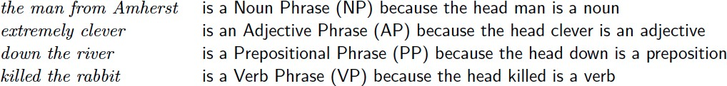
Constituent Phrases
Usually named based on the word that heads the constituent:
Words can also act as phrases
Joe grew potatoes
Joe and potatoes are both nouns and noun phrases
Compare with: The man from Amherst grew beautiful russet potatoes. Joe appears in a place that a larger noun phrase could have been.
Syntax
Week 5: Lecture 1
5 / 14

Slide 6
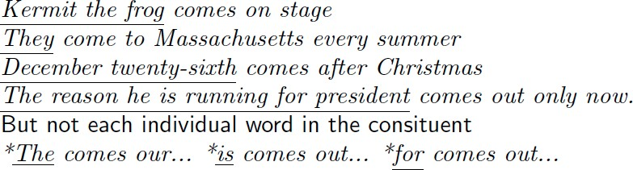
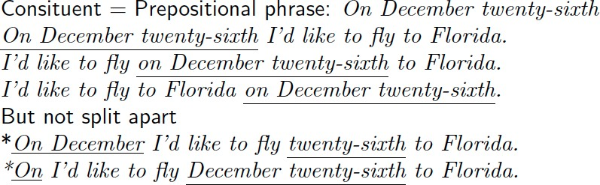
Evidence that constituency exists
They appear in similar environments
Can be placed in a number of different locations
Syntax
Week 5: Lecture 1
6 / 14

Slide 7
Modeling Constituency: what tool do we need?
Syntax
Week 5: Lecture 1
7 / 14

Slide 8
Modeling Constituency
Context-free grammar
The most common way of modeling constituency
Consists of production Rules
These rules express the ways in which the symbols of the language can be grouped and ordered together
Example
Noun phrase can be composed of either a ProperNoun or a determiner (Det) followed by a Nominal; a Nominal can be more than one nouns
NP → Det Nominal
NP → ProperNoun
Nominal → Noun | Noun Nominal
Syntax
Week 5: Lecture 1
8 / 14

Slide 9
CFG for Languages
CFG: G = (T, N, S, R)
T: set of terminals
N: set of non-terminals
For NLP, we distinguish out a set P ⊂ N of pre-terminals, which always rewrite as terminals
S : start symbol
R: Rules/productions of the form X → γ, X ∈ N and γ ∈ (T ∪ N)∗
Terminals and pre-terminals
Terminals mainly correspond to words in the language while pre-terminals mainly correspond to POS categories
Syntax
Week 5: Lecture 1
9 / 14

Slide 10
CFG for Languages
Example
NP → Det Nominal
NP → ProperNoun
Nominal → Noun | Noun Nominal
Now, these can be combined with other rules, that express facts about a lexicon.
Det → a
Det → the
Noun → flight
Can you identify the terminal, non-terminals and preterminals?
Syntax
Week 5: Lecture 1
10 / 14

Slide 11
CFG as a generator
NP → Det Nominal
NP → ProperNoun
Nominal → Noun | Noun Nominal
Det → a
Det → the
Noun → flight Generating ‘a flight’:
NP→ Det Nominal
→ Det Noun → a Noun → a flight
Thus a CFG can be used to randomly generate a series of strings
This sequence of rule expansions is called a derivation of the string of words, usually represented as a tree
Syntax
Week 5: Lecture 1
11 / 14

Slide 12
CFGs and Grammaticality
A CFG defines a formal language = set of all sentences (string of words) that can be derived by the grammar
Sentences in this set are said to be grammatical
Sentences outside this set are said to be ungrammatical
Syntax
Week 5: Lecture 1
12 / 14

Slide 13
CFGs and Recursion
Recursive Definition PP → Prep NP NP → Noun PP
Example Sentence
[_{S}The mailman ate his [_{NP} lunch [_{PP} with his friend [_{PP} from the cleaning staff
[_{PP} of the building [_{PP} at the intersection [_{PP} on the north end [_{PP} of town]]]]]]].
Syntax
Week 5: Lecture 1
13 / 14

Slide 14
What does Context stand for in CFG?
The notion of context has nothing to do with the ordinary meaning of word context in language
All it really means is that the non-terminal on the left-hand side of a rule is out there all by itself (free of context)
A → BC
I can rewrite A as B followed by C regardless of the context in which A is found
Or when I see a B followed by a C, I can infer an A regardless of the surrounding context
Syntax
Week 5: Lecture 1
14 / 14

Slide 15
Syntax -Parsing I
Pawan Goyal
CSE, IIT Kharagpur
Week 5: Lecture 2
Syntax
Week 5: Lecture 2
1 / 60

Slide 16
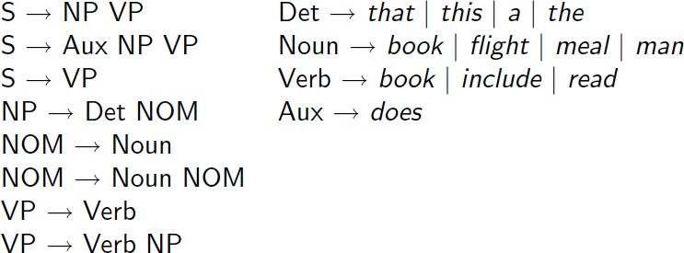
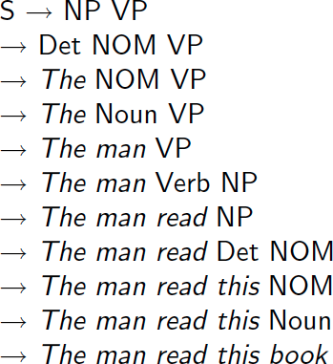
Grammar Rewrite Rules
Syntax
Week 5: Lecture 2
2 / 60

Slide 17
Parse Tree
Syntax
Week 5: Lecture 2
3 / 60

Slide 18
What is Parsing?
The process of taking a string and a grammar and returning all possible parse trees for that string
That is, find all trees, whose root is the start symbol S, which cover exactly the words in the input
What are the constraints? “book that flight”
There must be three leaves, book, that and flight
The tree must have one root, the start symbol S
Give rise to two search strategies: top-down (goal-oriented) and
bottom-up (data-directed)
Syntax
Week 5: Lecture 2
4 / 60

Slide 19
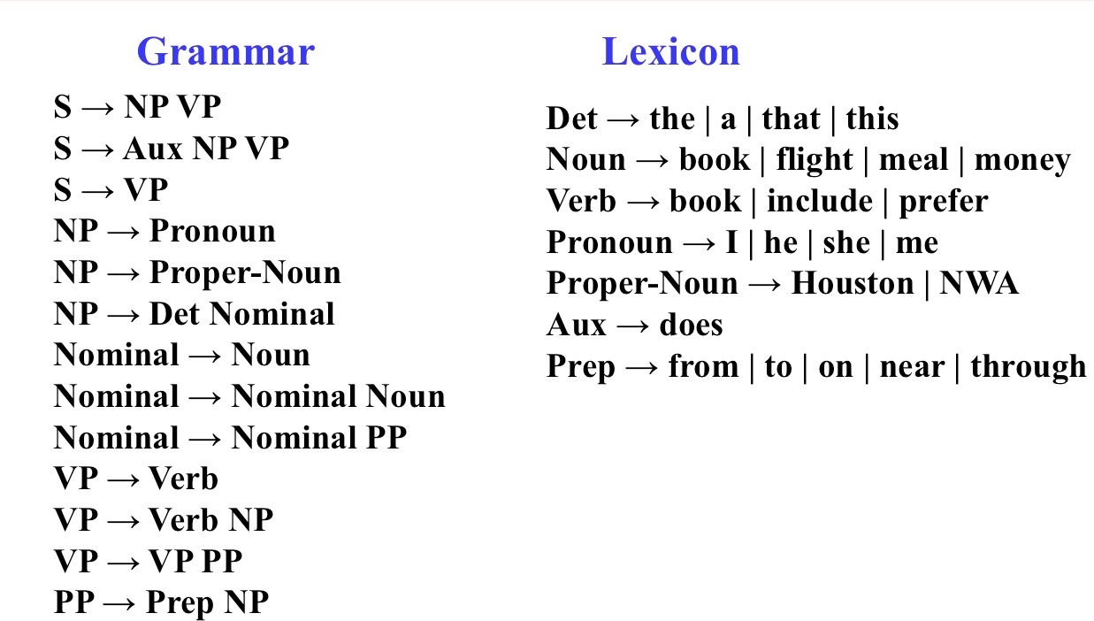
Parsing
Syntax
Week 5: Lecture 2
5 / 60

Slide 20
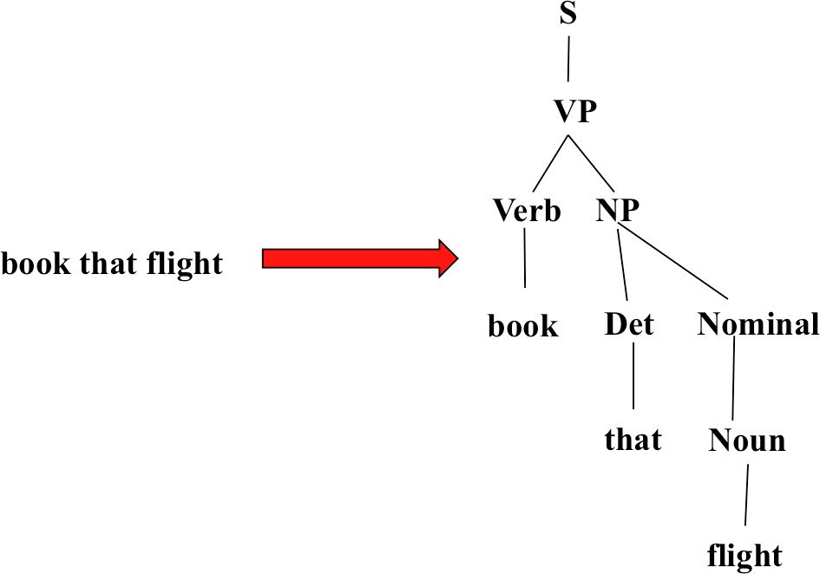
Parsing
Syntax
Week 5: Lecture 2
6 / 60

Slide 21
Top-Down Parsing
Searches for a parse tree by trying to build upon the root node S down to the leaves
Start by assuming that the input can be derived by the designated start symbol S
Find all trees that can start with S, by looking at the grammar rules with S
on the left-hand side
Trees are grown downward until they eventually reach the POS categories at the bottom
Trees whose leaves fail to match the words in the input can be rejected
Syntax
Week 5: Lecture 2
7 / 60

Slide 22
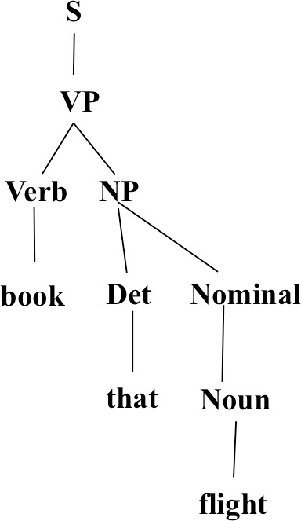
Top-Down Parsing
Syntax
Week 5: Lecture 2

Slide 23
Bottom-Up Parsing
The parser starts with the words of the input, and tries to build trees from the words up, by applying rules from the grammar one at a time
Parser looks for the places in the parse-in-progress where the right-hand-side of some rule might fit.
Syntax
Week 5: Lecture 2

Slide 24
Bottom-Up Parsing
Syntax
Week 5: Lecture 2

Slide 25
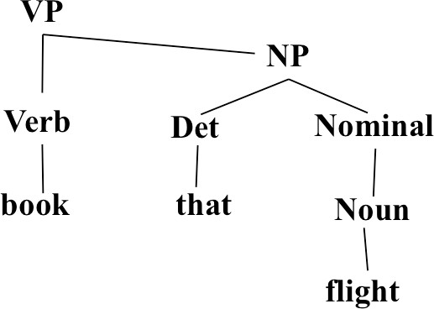
Bottom-Up Parsing
Syntax
Week 5: Lecture 2

Slide 26
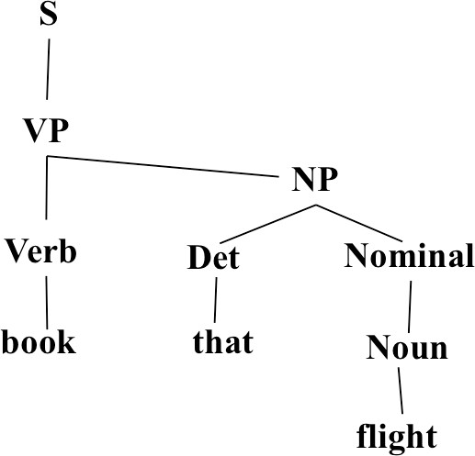
Bottom-Up Parsing
Syntax
Week 5: Lecture 2

Slide 27
Top-Down vs. Bottom-Up
Top down never explores options that will not lead to a full parse, but can explore many options that never connect to the actual sentence.
Bottom up never explores options that do not connect to the actual sentence but can explore options that can never lead to a full parse.
Relative amounts of wasted search depend on how much the grammar branches in each direction.
Syntax
Week 5: Lecture 2
56 / 60

Slide 28
Dynamic Programming Parsing
To avoid extensive repeated work, must cache intermediate results, i.e. completed phrases.
Caching (memoizing) critical to obtaining a polynomial time parsing (recognition) algorithm for CFGs.
Dynamic programming algorithms based on both top-down and bottom-up search can achieve O(n³) recognition time where n is the length of the input string.
Syntax
Week 5: Lecture 2
57 / 60

Slide 29
Dynamic Programming Parsing Methods
CKY (Cocke-Kasami-Younger) algorithm: bottom-up, requires normalizing the grammar
Earley Parser - top-down, does not require normalizing grammar, more complex
More generally, chart parsers retain completed phrases in a chart and can combine top-down and bottom-up searches.
Syntax
Week 5: Lecture 2
58 / 60

Slide 30
CKY Algorithm
Grammar must be converted to Chomsky normal form (CNF) in which all productions must have
Either, exactly two non-terminals on the RHS
Or, 1 terminal symbol on the RHS
Parse bottom-up storing phrases formed from all substrings in a triangular table (chart)
Syntax
Week 5: Lecture 2
59 / 60

Slide 31
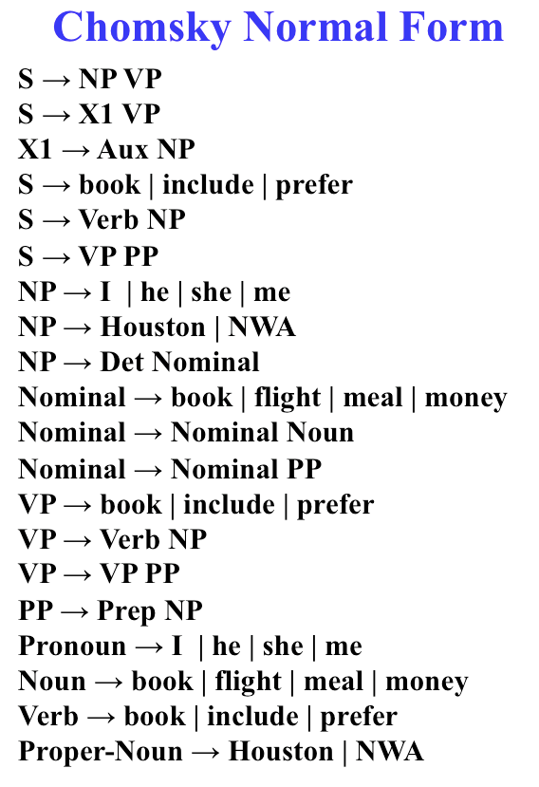
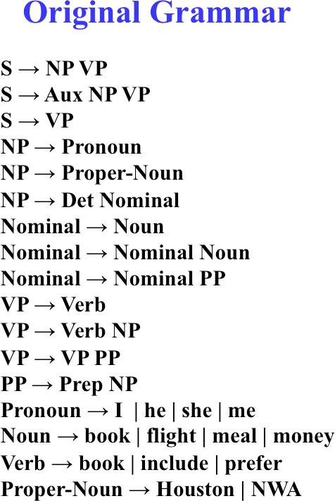
Converting to CNF
Syntax
Week 5: Lecture 2
60 / 60

Slide 32
Syntax -CKY, PCFGs
Pawan Goyal
CSE, IIT Kharagpur
Week 5: Lecture 3
Syntax
Week 5: Lecture 3
1 / 14

Slide 33
CKY Algorithm
Let n be the number of words in the input. Think about n + 1 lines separating them, numbered 0 to n.
x_{ij} will denote the words between line i and j
We build a table so that x_{ij} contains all the possible non-terminal spanning for words between line i and j.
We build the Table bottom-up.
Home Exercise
Use CKY algorithm to find the parse tree for “Book the flight through Houston” using the CNF form shown in the previous slide.
Syntax
Week 5: Lecture 3
2 / 14

Slide 34
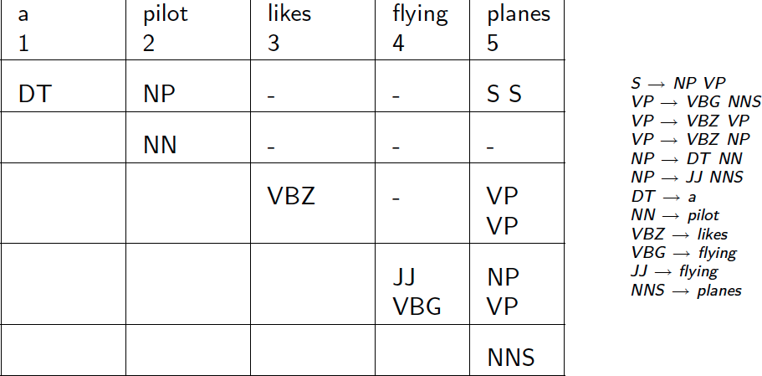
CKY for CFG
Syntax
Week 5: Lecture 3
4 / 14

Slide 35
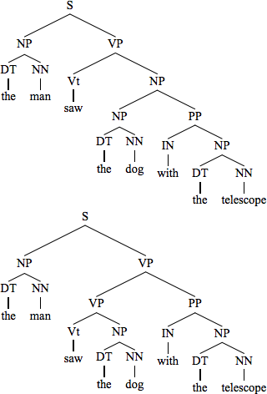
What about Ambiguities?
Syntax
Week 5: Lecture 3
5 / 14

Slide 36
Probabilistic Context-free grammars (PCFGs)
PCFG: G = (T, N, S, R, P)
T: set of terminals
N: set of non-terminals
For NLP, we distinguish out a set P ⊂ N of pre-terminals, which always rewrite as terminals
S : start symbol
R: Rules/productions of the form X → γ, X ∈ N and γ ∈ (T ∪ N)∗ P(R) gives the probability of each rule.
∀X ∈ N, ^{X} P(X → γ) = 1
X→γ∈R
Syntax
Week 5: Lecture 3
6 / 14

Slide 37
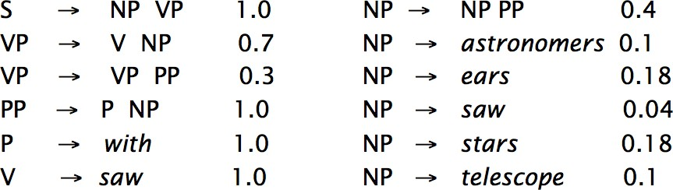
A Simple PCFG (in CNF)
Syntax
Week 5: Lecture 3

Slide 38
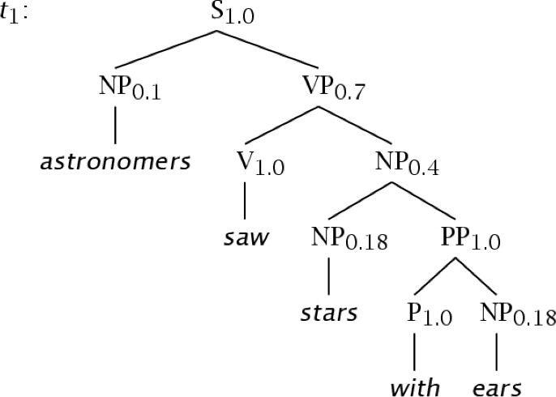
Example Trees
Syntax
Week 5: Lecture 3

Slide 39
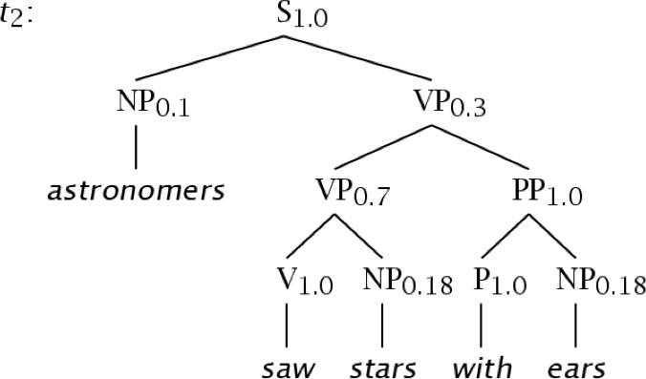
Example Trees
Syntax
Week 5: Lecture 3

Slide 40
Probability of trees and strings
P(t): The probability of tree is the product of the probabilities of the rules used to generate it
P(w_{1n}): The probability of the string is the sum of the probabilities of the trees which have that string as their yield
Syntax
Week 5: Lecture 3

Slide 41
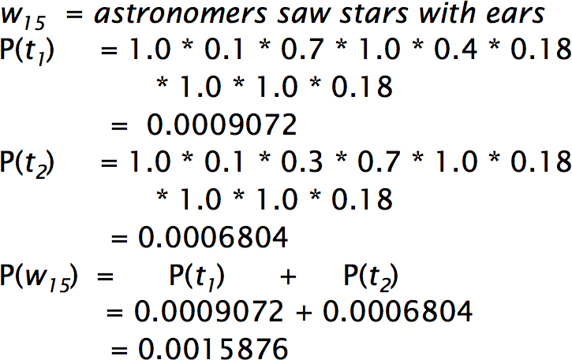
Tree and String probabilities
Syntax
Week 5: Lecture 3
11 / 14

Slide 42
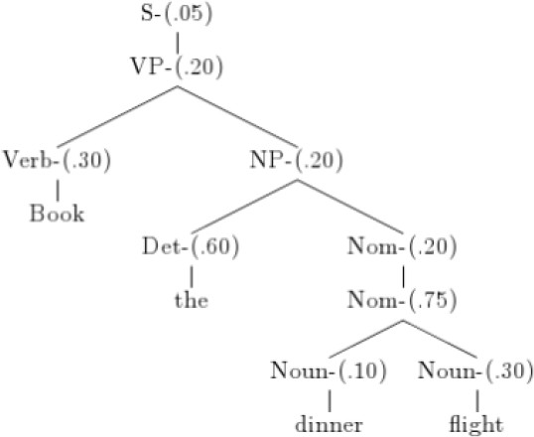
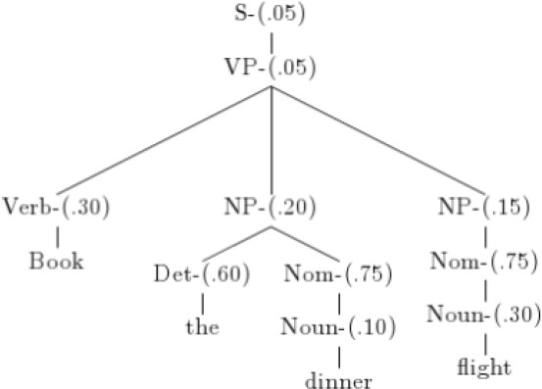
“Book the dinner flight”
Probabilities
Parse tree 1: .05 × .20 × .30 × .20 × .60 × .20 × .75 × .10 × .30 = 1.62 × 10⁻⁶
Parse tree 2: .05 × .05 × .30 × .20 × .60 × .75 × .10 × .15 × .75 × .30 =
2.28 × 10⁻⁷
Syntax
Week 5: Lecture 3
12 / 14

Slide 43
Features of PCFGs
As the number of possible trees for a given input grows, a PCFG gives some idea of the plausibility of a particular parse
But the probability estimates are based purely on structural factors, and do not factor in lexical co-occurrence. Thus, PCFG does not give a very good idea of the plausibility of the sentence.
Real text tends to have grammatical mistakes. PCFG avoids this problem by ruling out nothing, but by giving implausible sentences a low probability
In practice, a PCFG is a worse language model for English than an n-gram model
All else being equal, the probability of a smaller tree is greater than a larger tree
Syntax
Week 5: Lecture 3
13 / 14

Slide 44
Important Questions?
Let W_{1m} be a sentence, G a grammar, t a parse tree What is the most likely parse of sentence?
argmax_{t}P(t|w_{1m}, G)
What is the probability of a sentence?
P(w_{1m}|G)
How to learn the rule probabilities in the grammar G?
Syntax
Week 5: Lecture 3
14 / 14

Slide 45
PCFGs - Inside-outside probabilities
Pawan Goyal
CSE, IIT Kharagpur
Week 5: Lecture 4
Syntax
Week 5: Lecture 4
1 / 14

Slide 46
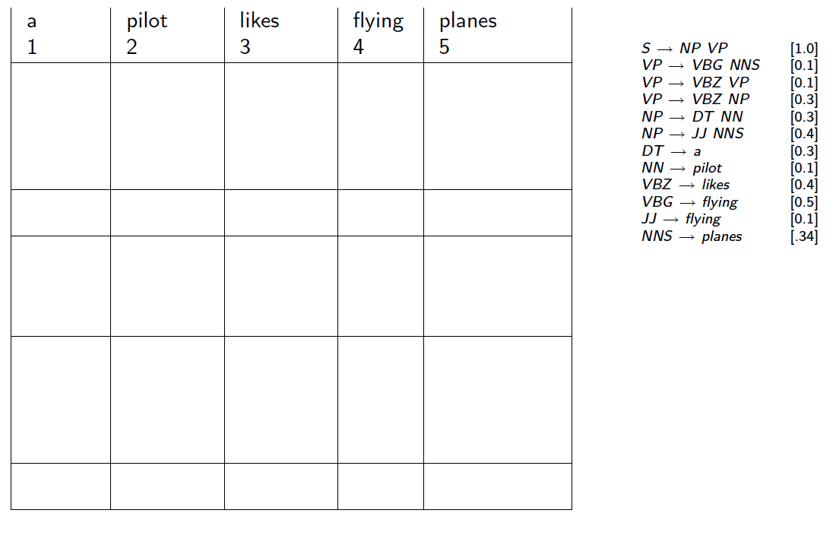
How to find the most likely parse?: CKY for PCFG
Syntax
Week 5: Lecture 4
2 / 14

Slide 47
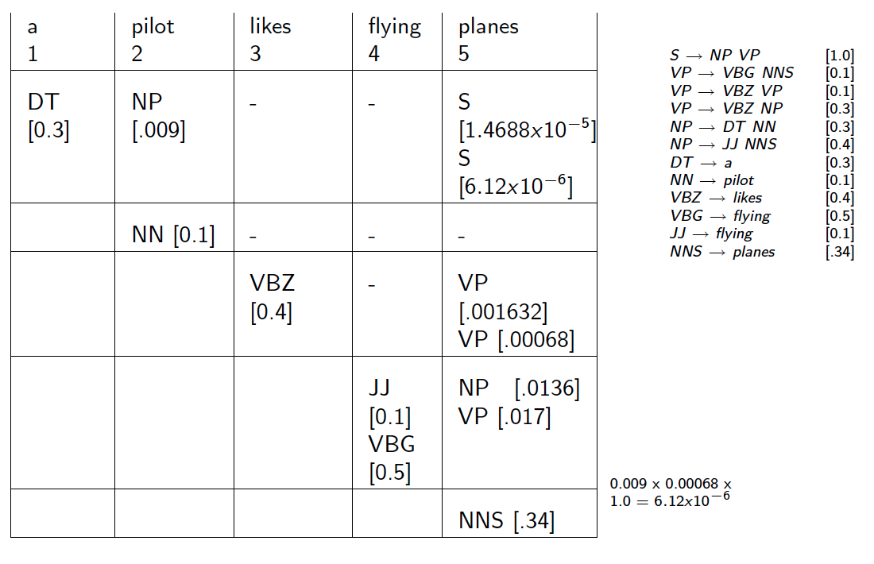
CKY for PCFG
Syntax
Week 5: Lecture 4
3 / 14

Slide 48
Probability of a String
P(w_{1m}|G)
In general, simply summing the probabilities of all possible parse trees is not an efficient way to calculate the string probability
We use inside algorithm, a dynamic programming algorithm based on inside probabilities.
Syntax
Week 5: Lecture 4
4 / 14

Slide 49
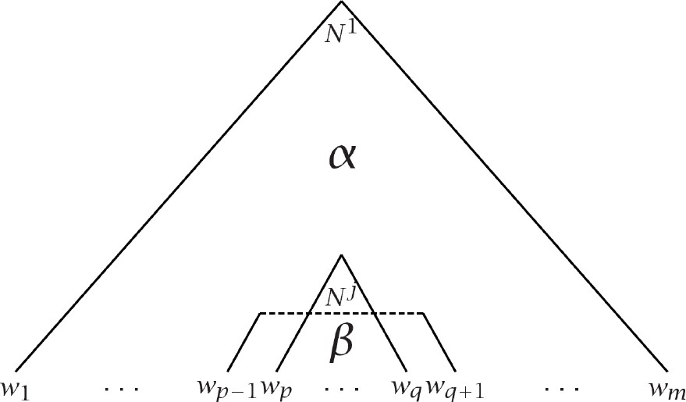
Inside and Outside Probabilities
Outside: α_{j}(p, q) = P(w_{1(p−1)}, N^{j}_{pq}, w_{(q+1)m}|G)
Inside: β_{j}(p, q) = P(w_{pq}|N^{j}_{pq}, G)
Syntax
Week 5: Lecture 4
5 / 14

Slide 50
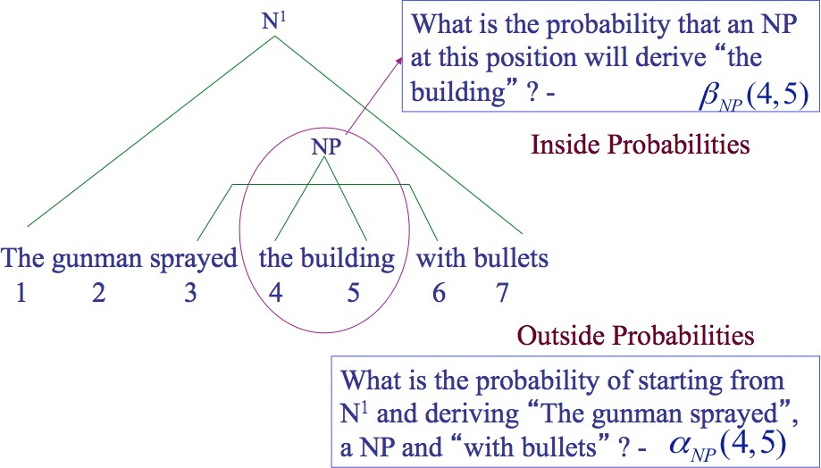
Inside-outside probabilities
Syntax
Week 5: Lecture 4
6 / 14

Slide 51
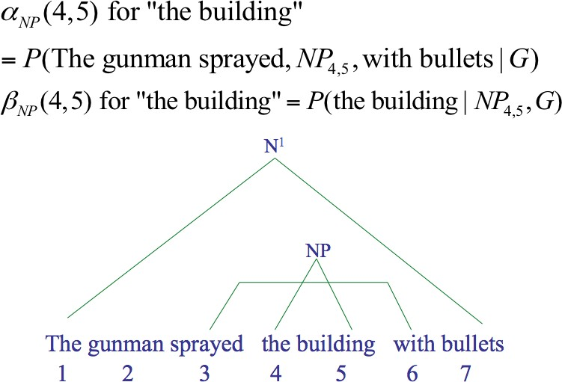
Inside-outside probabilities
Syntax
Week 5: Lecture 4
7 / 14

Slide 52
Inside Probabilities: Base Step
β_{j}(p, q) = P(w_{pq}|N^{j}_{pq}, G)
Base case
β_{j}(k, k) = P(w_{kk}|N^{j}_{kk}, G)
= P(N^{j} → w_{k}|G)
Base case for pre-terminals only
E.g., suppose N^{j} = NN is being considered and NN → building is one of the rules with probability 0.5
β_{NN} (5, 5) = P(building|NN_{5,5}, G) = P(NN_{5,5} → building|G)
Syntax
Week 5: Lecture 4
8 / 14

Slide 53
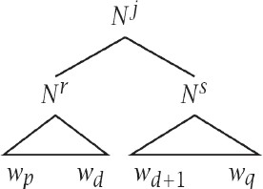
Inside Probabilities: Induction Step
Assuming Chomsky Normal Form, the first rule must be of the form N^{j} → N^{r} N^{s}
q−1
XX
β (p, q) = P
j r s
j
(N → N N )β (p
, d)β (d +1, q)
r
s
r,s d=p
Consider different splits of the words - indicated by d
E.g., the huge building
Consider different non-terminals to be used in the rule: E.g., NP → DT NN, NP → DT NNS
Syntax
Week 5: Lecture 4
9 / 14

Slide 54
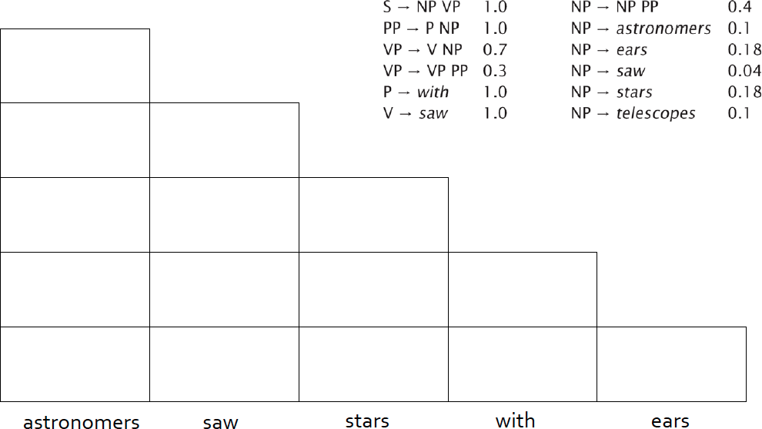
Calculation of inside probabilities
Syntax
Week 5: Lecture 4

Slide 55
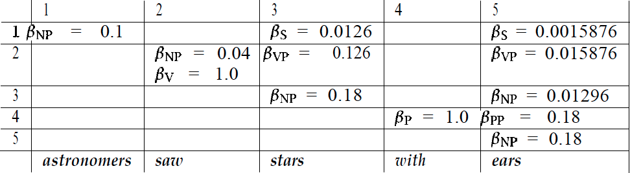
Calculation of inside probabilities
Syntax
Week 5: Lecture 4

Slide 56
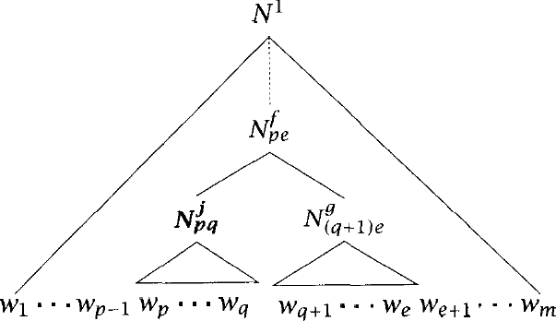
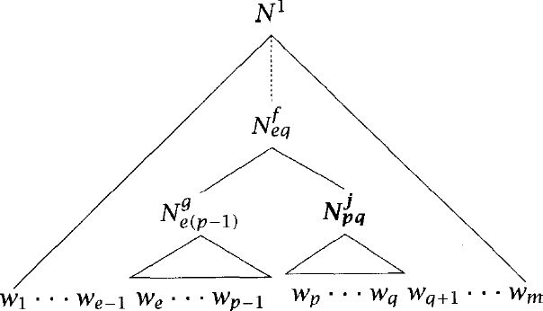
Outside Probabilities
Compute top-down (after inside probabilities)
Base Case
α₁(1, m) = 1
α_{j}(1, m) = 0, j ≠ 1
Induction
Syntax
Week 5: Lecture 4
12 / 14

Slide 57
Outside Probabilities: Induction
X X
m
α_{j}(p, q) =
f j g
α (p, e)P(N → N N )β (q + 1
, e)
f
g
f ,g e=q+1
XX
p−1
+
f g j
α (e, q)P(N → N N )β (e
, p − 1)
f
g
f ,g e=1
Syntax
Week 5: Lecture 4

Slide 58
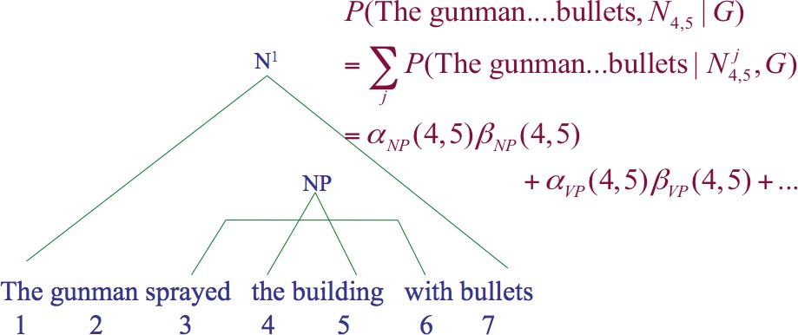
Product of inside-outside probabilities
α_{j}(p, q)β_{j}(p, q) = P(w_{1(p−1)}, N^{j}_{pq}, w_{(q+1)m}|G)P(w_{pq}|N^{j}_{pq}, G) = P(w_{1m}, N^{j}_{pq}|G)
The probability of the sentence and that there is some consistent spanning from word p to q is given by:
P(w_{1m}, N_{pq}|G) = ^{X} α_{j}(p, q)β_{j}(p, q) = P(N₁ → w_{1m}, N_{pq} → w_{pq}|G)
Syntax
Week 5: Lecture 4
14 / 14

Slide 59
Inside-outside probabilities
Pawan Goyal
CSE, IIT Kharagpur
Week 5: Lecture 5
Syntax
Week 5: Lecture 5
1 / 11

Slide 60
How to get the rule probabilities
Parsed Training Data
You can count!
C(N^{j} → δ)
_{P}ˆ
j
(N → δ) = .
j
γ
C(N → γ)
But what if the training data is not available?
i.e. gold standard parse is not known.
Underlying CFG is known and we are given a set of sentences For each sentence, we can find out all the possible parses
Maximize the likelihood of the sentences in the data under the PCFG constraints
Syntax
Week 5: Lecture 5
2 / 11

Slide 61
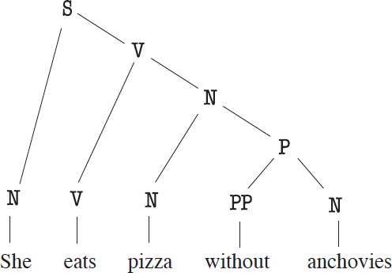
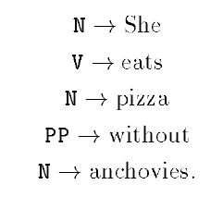
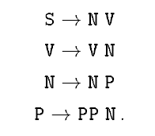
Example data
Rules of the form A → w
Rules of the form A → BC
Syntax
Week 5: Lecture 5
3 / 11

Slide 62
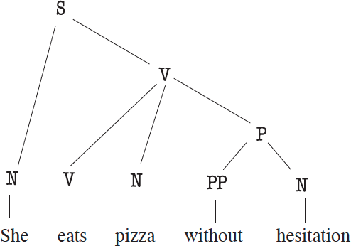

Example data
Is any other parse possible for She eats pizza without anchovies syntactically? Consider She eats pizza without hesitation
New Context-free rules:
Syntax
Week 5: Lecture 5
4 / 11

Slide 63
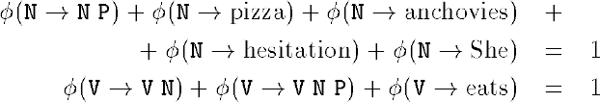
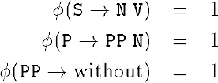
Estimating the model parameters
We need to find probabilities such as
φ(S → N V)
φ(N → pizza)
Requirements
For each non-terminal A, the derivation probabilities sum up to 1
^{X} φ(A → α) = 1
α
For the example grammar:
Syntax
Week 5: Lecture 5
5 / 11

Slide 64
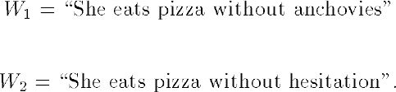
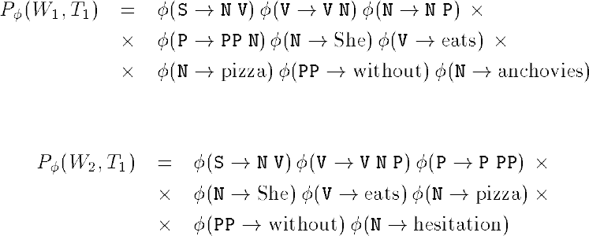
Likelihood computation
Syntax
Week 5: Lecture 5
6 / 11

Slide 65
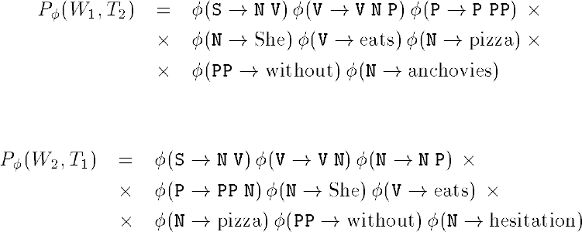
Likelihood computation
Likelihood of the corpus
X
Probability of a sentence W : P (W) = P (W, T)
φ φ
T
If the training data comprises of sentences W₁, W₂,..., W_{N} , then the likelihood is
L(φ) = P_{φ}(W₁)P_{φ}(W₂)··· P_{φ}(W_{N} )
Syntax
Week 5: Lecture 5
7 / 11

Slide 66
Likelihood maximization
Approach
Starting at some initial parameters φ, re-estimate to obtain new parameters φ^{j}
for which L(φ^{j}) ≥ L(φ). Repeat until convergence
Syntax
Week 5: Lecture 5
8 / 11

Slide 67
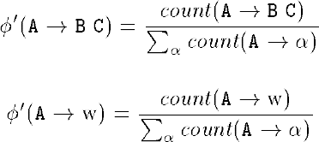
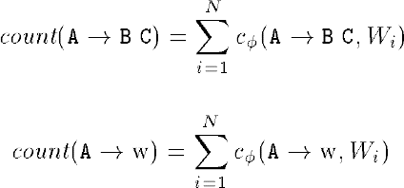
Parameter Estimation
Given some rule probabilities φ and training corpus W₁, W₂ . . . W_{n}, the new parameters are obtained as:
What is count(.)?
c_{φ}(A → α, W_{i}) is the expected number of times (A → α) is used in generating the sentence W_{i}, when the rule probabilities are given by φ
Syntax
Week 5: Lecture 5
9 / 11

Slide 68
Computing Expected counts
Inside probabilities
The nonterminal A derives the string of words w_{i}, . . . w_{j} in the sentence :
β_{ij}(A) = P_{φ}(A⇒∗w_{i} . . . w_{j})
Outside probabilities
Beginning with the start symbol S we can derive the string
w₁ . . . w_{i−1}Aw_{j+1} . . . w_{n} : α_{ij}(A) = P_{φ}(S⇒∗w₁ . . . w_{i−1}Aw_{j+1} . . . w_{n})
Expected count
φ(A → BC)
P_{φ}(W)
X
c (A → BC, W) =
α (A)β (B)β (C)
φ
ik ij j+1,k
1≤i≤j≤k≤n
φ(A → w)
X
c_{φ}(A → w, W) =
α (A)
P_{φ}(W)
ii
1≤i≤n
Syntax
Week 5: Lecture 5
10 / 11

Slide 69
And how to compute inside-outside probabilities
Inductively, as discussed earlier
β_{ii}(A) = φ(A → w_{i}) α_{1n}(S) = 1
Syntax
Week 5: Lecture 5
11 / 11

